Slide 1

LIFE WITHOUT JS The programming language of HTML and the Web
Alex Frenkel
19.02.2020

Slide 2


1995 & Brendan Eich
Scheme programming language in the browser, that maintained a syntax
Resemble Java
Curly-bracket programming language
10 days later
Notes:
Multi-paradigm language, meaning developers can apply there own language patterns too
Later in December it was renamed to JS and also integrated into Netscape Navigator version 2
It was renamed JS, because it made it to sound like the little brother of the hottest programming language of the day: JAVA
Object-oriented programming – uses data structures consisting of data fields and methods together with their interactions (objects) to design programs Class-based – object-oriented programming in which inheritance is achieved by defining classes of objects, versus the objects themselves

Slide 3
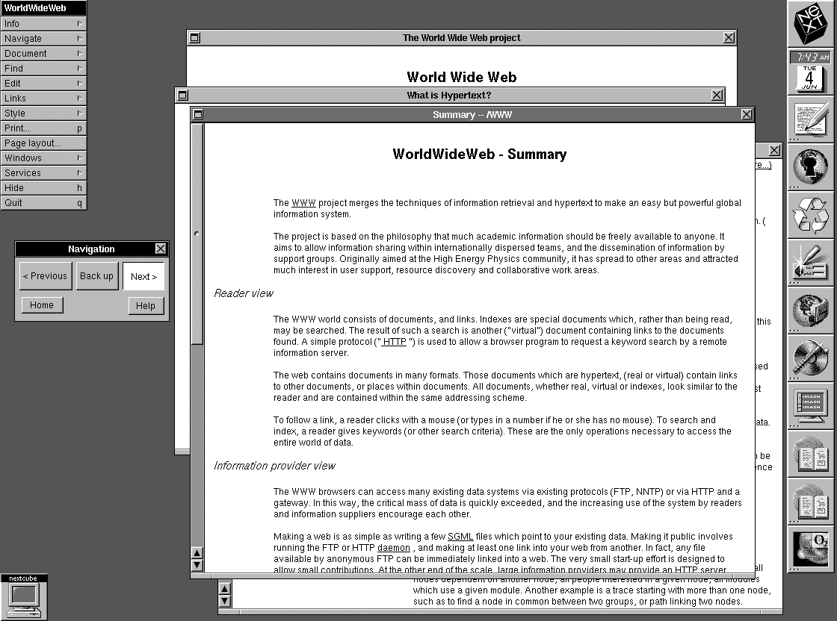
WorldWideWeb (Nexus) 1990

Slide 4
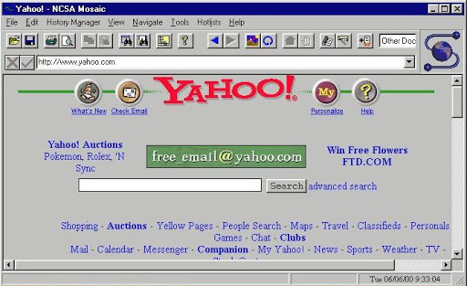
Mosaic 1993
DOM
Notes:
1993 – Mosaic was the first browser to allow images embedded in text making it “the world’s first most popular browser” => no JS support
UniX, Macintosh, Windows ports
It had DOM – wasn’t even closed to be standardised yet

Slide 5
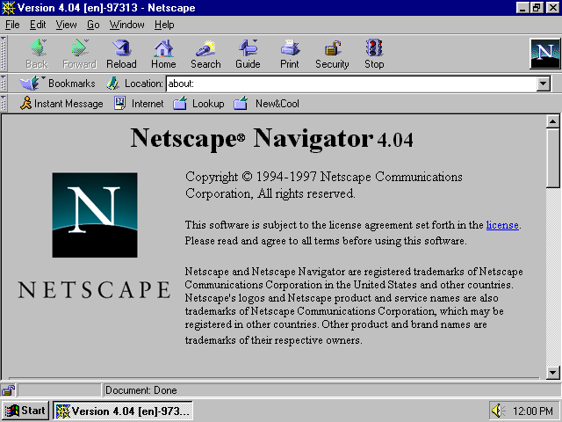
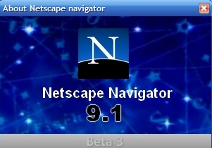
Netscape Navigator 1994
Notes:
1994 – A noticeable improvement to Mosaic came Netscape Navigator.
VERSION 2 SUPPORTED JS

Slide 6
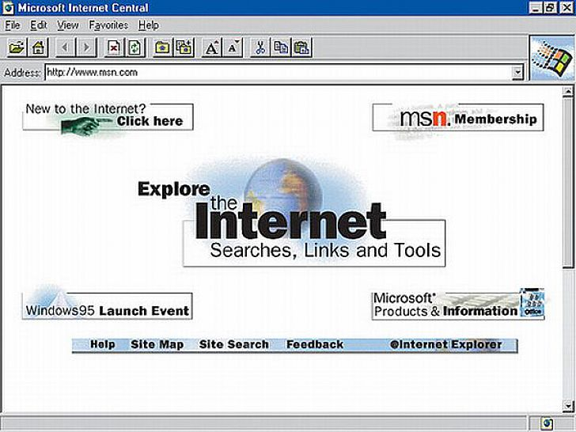
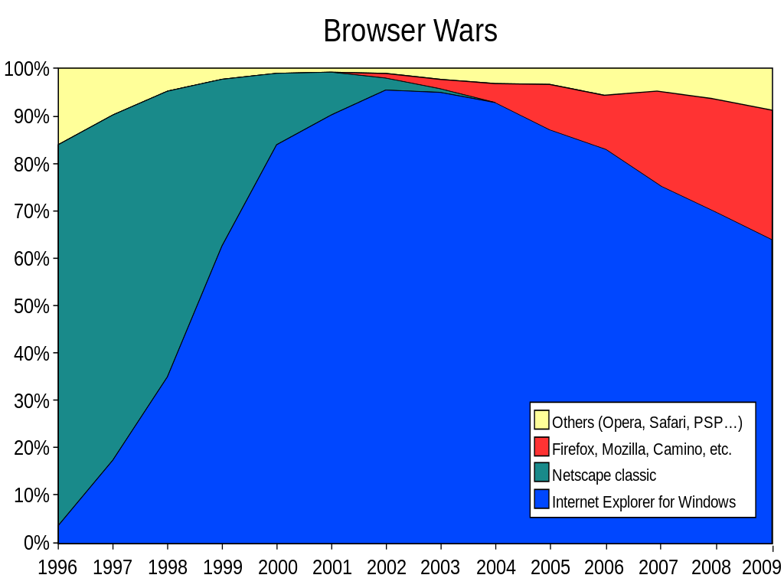
Internet Explorer 1995
The First Browser War (1995 – 2002)
Notes:
By 1996 controlled 80% of the browser market
1995 – Internet Explorer made its debut as Microsoft’s first web browser.
Browser war
August version 1
December version 2 – IT SUPPORTED JS

Slide 7

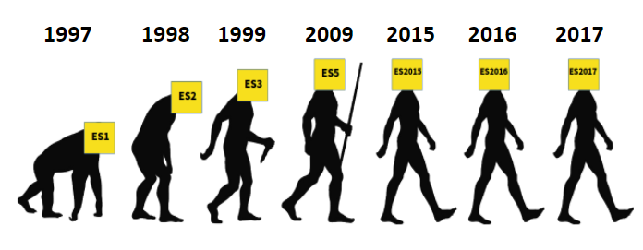

Microsoft and JavaScript
Notes:
MS reverse engineered JS and renamed it Jscript
1996: 2 almost identical languages
By the internet growing rapidly, people realized JS needed to be standardised
ECMA: neutral party, responsible for setting standards in the IT industry since 1961
By 1997 ECMA Script version 1 EC1 was ready and released
IN the early 2000s, MS didn’t really cared about playing by the rules is the spec.
MS controlled about 90% of the browser market in the early 00s.
MS just went on to do its own things and implemented its own extensions for javascript,
WHICH CREATED FRAGMANTATIONS, THAT DEVELOPERS STILL HAVE TO DEAL WITH TODAY WHEN SUPPORTING THIS LEGACY VERSIONS OF IE

Slide 8
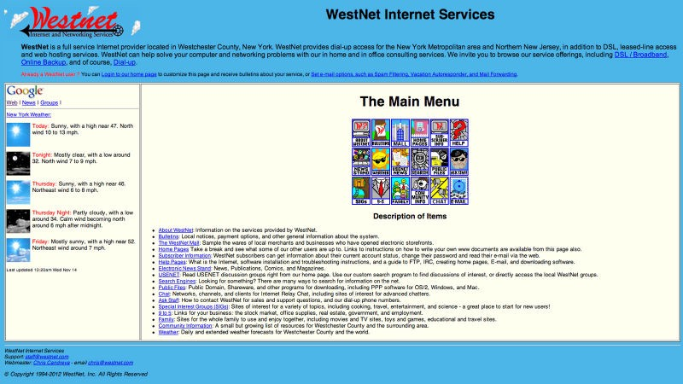
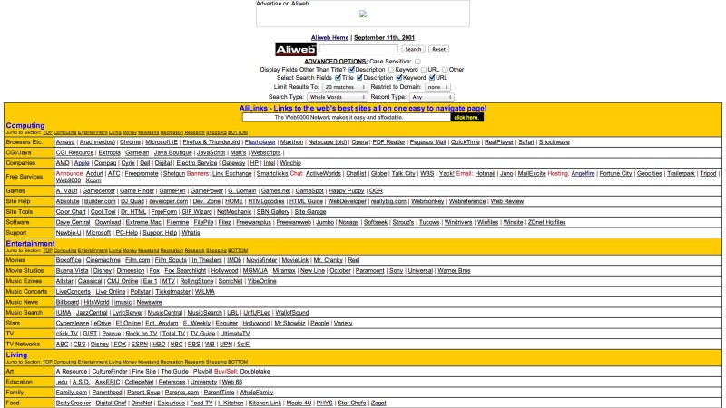
The pre-JavaScript era (<1995)
Notes:
Browser weren’t very dynamic
Here’s WestNet, an Internet provider, founded in 1994.
IFINDIT, another sort of search engine, back in 1995.
Aliweb or Archie Like Indexing for the Web is one of the very first search engines. A fact attested by the prehistoric look of it.
Need for a ‘glue language’ to make the site more interactive
All websites in the pre-JS era worked without JavaScript. Yes they were a bit more rudimentary and slow, but they worked. Even some websites today work without JavaScript, but the whole purpose of creating JavaScript was to make the web a better place. A more accessible, user friendly place. Functional and visually appealing. Modern if you will.

Slide 9

Developers, Browsers, Frustration
2006
Had extremely well-done documentation
More complex and interactive applications that worked far more reliable on all browser
Notes:
Developers became more frustrated about building web application that ran on all browser
Had extremely well done documentation
Enabled developers to build far more complex and interactive application that worked far more reliable on all browser
which had lower chance to brake n another browser

Slide 10
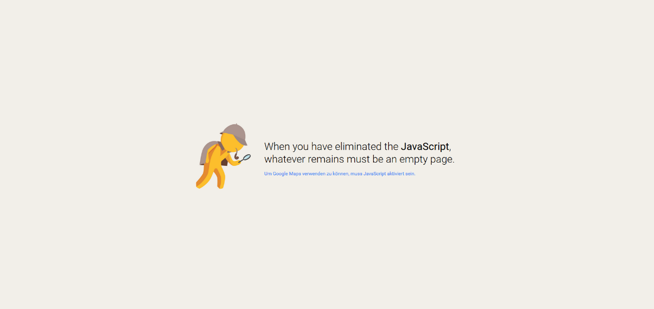

Do websites without JavaScript work?

Slide 11
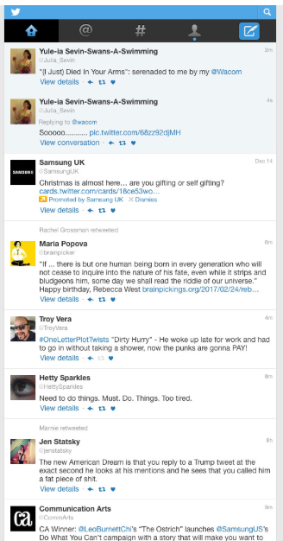
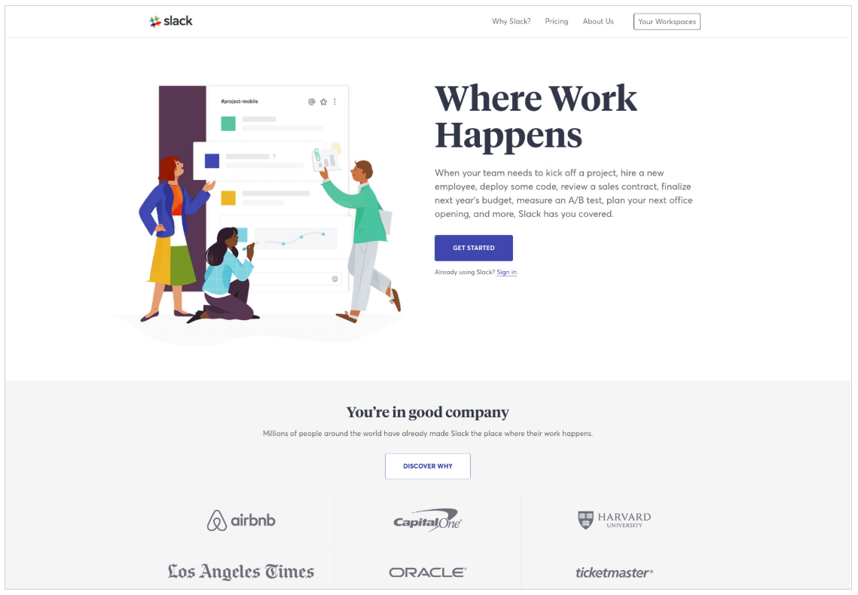
Notes:
In short, Twitter will actually redirect you to a pared-down, mobile version of Twitter. It’s fully functional, except for features like feeds that update live, and so on.
You might need JavaScript to actually run a Slack chatroom, but the rest of the client-facing site looks and works just fine.

Slide 12
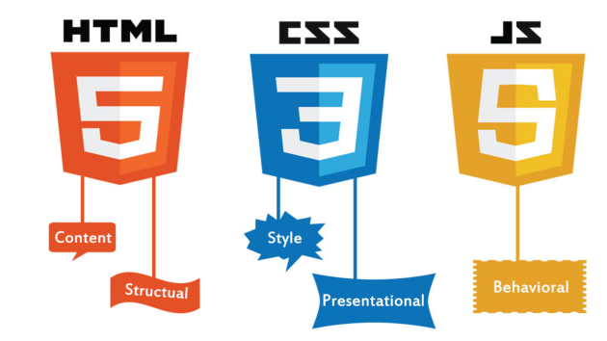
Post-JavaScript
Notes:
You can create a working webpage with just HTML and CSS, but you do need JavaScript to be able to create a website that is meant to be used by users, not just showcased. Every website needs at least one snippet of JavaScript for Google Analytics so you will be using JavaScript nonetheless.
Thinking about the bottom line, about the user experience you have to take into consideration the need for JavaScript. It can bring a website to life through animations and it can offer a few practical necessities, like mobile/desktop detection and a good and usable comment section.
Without JS you will have a very basic but functional website with very limited possibilities. Websites like these still exist today, and some people still promote the non-JavaScript way to surface the Internet, but I think we’ve moved past that as a way of development. Every website you will work on will have at least a few lines of JavaScript in it, this is our way now

Slide 13

Thank you

